Slide 1
Respiratory Disease Classification Using Lung Sounds with CNN-LSTM

Slide 2
Motivation
The aim of this project is to classify the Lung Sounds based on the different features present in that, also have to Classify the disease for better performance.

Slide 3
ABSTRACT
In order to analyze respiratory sounds on a computer, we developed a cost-effective and easy-to-use Algorithm that can be used with any device.
We employed two types of machine learning algorithms; Gammatone cepstrum coefficients features in a Convolutional Neural Network and Since using GTCC and STFC features with a CNN-LSTM algorithm.
We prepared four data sets for CNN-LSTM algorithm to classify respiratory audio: (1) healthy versus pathological classification; (2) rale, rhonchus, and normal sound classification; (3) singular respiratory sound type classification; and (4) audio type classification with all sound types.

Slide 4
INTRODUCTION
L UNG auscultation is one of the most popular diagnostic modalities used by the pulmonary experts to analyze the condition of the respiratory system.
When auscultating various areas on the anterior and posterior sides of the chest , lung sounds can be detected.
Lung sounds are indicative of different anatomical flaws in the lungs and provide accurate prognoses regarding respiratory health, resulting in more trustworthy medical tool for identifying respiratory disorders.
According to a recent study conducted by the world health organization (WHO), approximately ten million (M) people die each year as a result of respiratory diseases.

Slide 5
LITERAURE SURVEY
Title and Year | Author | Advantage | Disadvantage
Computerised Analysis of Telemonitored Respiratory Sounds for Predicting Acute Exacerbations of COPD- | M. A. Fernandez-Granero | High Accuracy | Supports 50Hz signals only
Computerized Respiratory Sound Analysis (CORSA): Recommended Standards for Terms and Techniques | R. X. A. Pramono, | Best results | Works with only Some Lungs sounds
Deep Convolutional Neural Networks and Data Augmentation for Acoustic Event Detection | N. Takahashi | Easy Operations | Support limited Databases

Slide 6
LITERAURE SURVEY
Title and Year | Author | Advantage | Disadvantage
Computerised Analysis of Telemonitored Respiratory Sounds for Predicting Acute Exacerbations of COPD- | M. A. Fernandez-Granero | High Accuracy | Supports 50Hz signals only
Computerized Respiratory Sound Analysis (CORSA): Recommended Standards for Terms and Techniques | R. X. A. Pramono, | Best results | Works with only Some Lungs sounds
Deep Convolutional Neural Networks and Data Augmentation for Acoustic Event Detection | N. Takahashi | Easy Operations | Support limited Databases

Slide 7
EXISTING SYSTEM
In existing work, the architecture of some well-known MFCC features when fed to Inception Network classifier used to classify the audio scenes.
Furthermore, it analyzed different methods of combining these features, and also of combining information from two channels when the data is in different format.
More recently, with appropriate changes from designing Inception Network for image analysis to taking into account speech-specific properties, the Inception Network is also found effective for speech recognition

Slide 8
PROBLEM DEFINITION
Existing Inception Network -based analysis requires significantly High computation Time.
Obviously classification based on these low-level(MFCC) features alone may not be accurate.
High complexity algorithm will result in poor performance

Slide 9
PROPOSED SYSTEM
In this article, one of the major objectives is to provide an automated algorithmic approach that can categorize lung sounds in a variety of diseased states.
Another objective of this present research work is to propose a lightweight deeplearning architecture that can classify lung sounds accurately while keeping parameter size and computational complexity less.
The majority of these respiratory diseases have almost similar kind of symptoms; therefore, it becomes difficult for the doctor to predict the actual disease just by hearing the lung sound only and requires additional tests, such as spirometry test.

Slide 10
PROPOSED SYSTEM
The novel contributions of the proposed framework are itemized as follows.
1) Designing a novel lightweight LSTM, namely, CNN_LSTM, to classify the lung sound efficiently, while keeping the architecture lightweight in terms of total trainable parameters and model storage size.

Slide 11
PROPOSED SYSTEM
2) Classification of seven respiratory diseases for the first time, utilizing three publicly available lung sound databases: ICBHI 2017 challenge database and chest wall lung sound database .
Engaging all the databases also ensures the robustness of the classification mechanism, as the DLM is trained with a wide variety of lung sounds.
3) Computing the ablation study and classification report containing the statistics of layers, parameters, accuracy, precision, recall, F1 score, and so on, in order to have a thorough performance/classification accuracy analysis of the proposed lightweight CNN_LSTM.

Slide 12
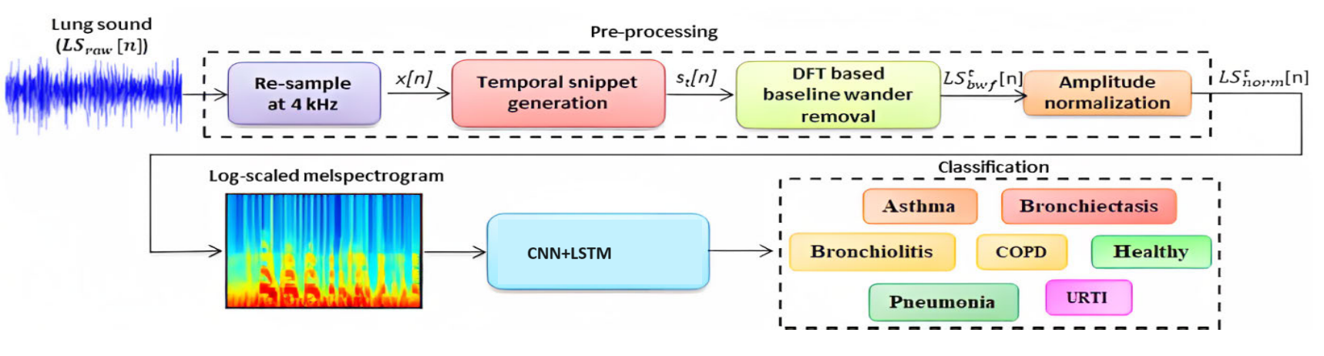
SYSTEM ARCHITECTURE

Slide 13
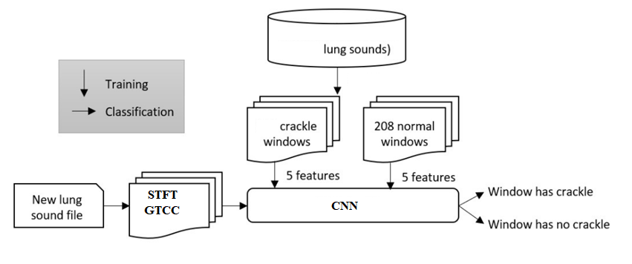
FLOW DIAGRAM

Slide 14
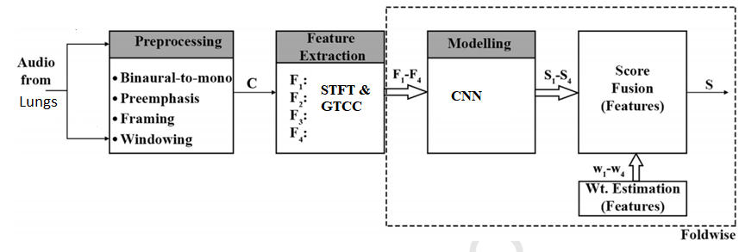
CLASS DIAGRAM

Slide 15
PROPOSED SYSTEM
The patterns in these are then summarized as a feature Fused STFT and GTCC set.
The features are used to train a model used to classify sounds as either normal or crackles.
There are several methods for feature extraction, and several classifiers with associated learning methods.

Slide 16
MODULES
Preprocessing
The preprocessing stage includes four submodules:
1) resampling;
2) temporal snippet generation (split the input signal or time series as a chunk of subseries, called snippets);
3) baseline removal using discrete Fourier transform (DFT)- based filtering

Slide 17
MODULES
Data Augmentation
We have used three separate databases in this study, as our primary goal is to categorize a wide range of respiratory disorders.
However, using all the audio signals from the three databases leads to a problem of class imbalance, where COPD is the majority class and the rest belong to the minority class.

Slide 18
MODULES
Extraction of TFR
Lung sound signals include significantly oscillating amplitudes and fluctuating frequency components, making analysis challenging.
Therefore, it is necessary to transform the signal from one domain to another in order to gain a comprehensive understanding of them.
Transformation techniques enable simultaneous capture of the details of time-domain and frequency-domain signals.

Slide 19
MODULES
Lightweight CNN-LSTM Network
Different CNN architectures use the TFR image of the lung sound signal, as input has been used in recent years to classify respiratory diseases from pathological lung sounds.
In this study, we developed a novel lightweight CNN-LSTM that can diagnose seven distinct respiratory disorders by extracting prominent features from TFR images obtained from the lung sound signal.

Slide 20
Project Advantages
The proposed system uses less resources.
The deep learning architecture which is computationally less complex than the conventional feature extraction and classification methods.
The best results in terms of accuracy from both the datasets were obtained with CNN classification.

Slide 21
APPLICATIONS:-
Used in various successful applications in both computer vision and Lung Signal recognition.
Applications of this system can be in context-aware and intelligent wearable Medical devices, and audio archive management systems.

Slide 22
SOFTWARES USED
HARDWARE REQUIREMENTS
System : Pentium Dual Core.
Hard Disk : 120 GB.
Monitor : 15’’ LED
Input Devices : Keyboard, Mouse
Ram : 4 GB
SOFTWARE REQUIREMENTS:
PYTHON LANGUAGE
ANACONDA IDE

Slide 23
CONCLUSION:-
We have presented a machine learning based approach for detecting crackles in sounds recorded using a stethoscope as part of a large health survey.
We evaluated several feature extraction methods, and classifiers using many sound recordings.
A simple 5-dimenstional layer and a CNN-LSTM Kernel performed best.
The low-dimensional feature vector makes the CNN-LSTM very fast and it can classify lung sounds in real-tome.

Slide 24
REFERENCE
[1] Pasterkamp, H.; Brand, P.L.; Everard, M.; Garcia-Marcos, L.; Melbye, H.; Priftis, K.N. Towards the standardisation of lung sound nomenclature. Eur. Respir. J. 2016, 47, 724–732. [CrossRef]
[2] M. Huijbregts, F. De Jong, Robust speech/non-speech classification in heterogeneous multimedia content, Speech Commun. 53 (2) (2021) 143–153.
[3] Huang, Y.; Meng, S.; Zhang, Y.; Wu, S.; Zhang, Y.; Zhang, Y.; Ye, Y.; Wei, Q.; Zhao, N.; Jiang, J.; et al. The respiratory sound features of COVID-19 patients fill gaps between clinical data and screening methods. medRxiv 2020.
[4] D. Barchiesi, D. Giannoulis, D. Stowell, M.D. Plumbley, Acoustic scene classification: classifying environments from the sounds they produce, IEEE Signal Process. Mag. 32 (3) (2015) 16–34.
[5] G.J. Brown, M. Cooke, Computational auditory scene analysis, Comput. Speech Lang. 8 (4) (1994) 297–336.
[6] D. Dubois, C. Guastavino, M. Raimbault, A cognitive approach to urban soundscapes: using verbal data to access everyday life auditory categories, Acta Acust. Acust. 92 (6) (2006) 865–874.

Slide 25
Thank you

